Slide 1

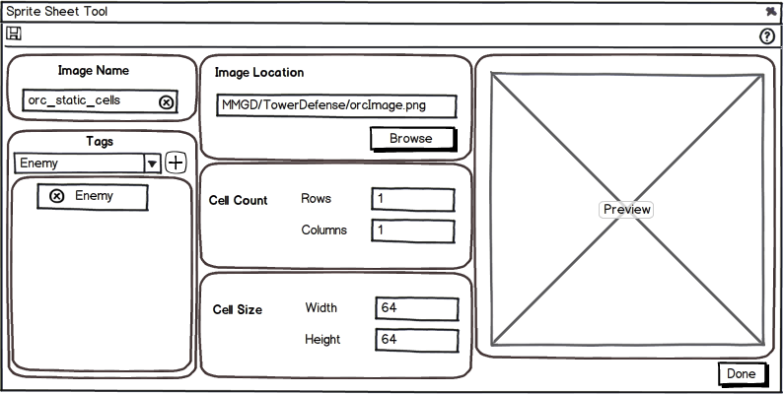
Static Sprite Tool
795x400
Notes:
Window Size – 795x400
Image Name – Will be blank when the user creates a new image, if they have opened an existing image it will populate with the name from that image. The user must fill in a name before they can save the image. They can only enter valid characters (A-Z, 0-9)
Cases:
If the user has opened an existing image and has changed the name, it will overwrite the original image, NOT create a new image
If a new image is created and the name already exists, a prompt dialog will tell the user that “An image with this name already exists.”
Image Location – The Browse button will open a file dialog for the user to browse to the selected image. The default will open to the users Pictures Library (C:\Users\DerekB\Pictures)
Cell count – Will cut up the image into cells for animation. It will contain 2 text fields, Rows and Columns. It will clamp from 1 – 100. Will default to 1 in each field.
Cell Size – Will only be visible when the user enters a number higher than 1 for the Cell Count. Sets the pixels size of the cells
Preview – Will display the current state of the image
Help – Will bring up the section for the Image Tool in the Help Wiki on the MMGD website
Template Tags – Already contain tags for the template that is open. Once the user selects a tag, they click on the Plus icon on the right of the dropdown to add that tag to the image for the Asset Selector to filter.
Tag List – Tags will appear in containers with an “X” to delete the tag from the list. For 1.0 the user will be limited to the tags provided by the template. In the future the user will be able to create their own tags and assign to the sprite sheet. The user will not be limited in how many they can assign so this view will need to scroll.
Cancel – Closes the Image Constructor and does not prompt the user if they want to Save any unsaved changes
Save – Will save any changes the user has made to either a new image or an existing one.
Cases:
If the Image Name is blank, a prompt dialog telling the user that they must name the image before saving
If a new image is created and the name already exists, a prompt dialog will tell the user that “An Image with this name already exists.

Slide 2
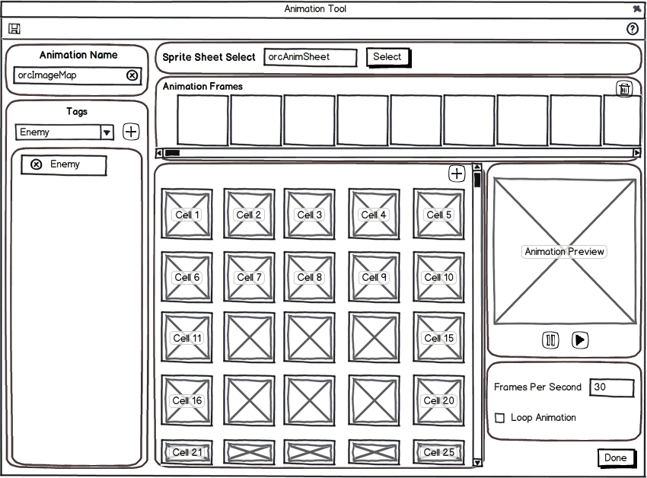
Animation Tool
850x600
Notes:
Window Size – 850x600
Image Select – user cannot type in the text field, only populates with the name of the asset selected through the Asset Selector. Select button brings up Asset Selector.
Cases:
If the user already has an image loaded but no animation frames, Select will bring up the Asset Selector without any prompts
If the user has created any frames of animation Selecting a new image will prompt the user that they are about to lose any unsaved work, do they want to continue
If the user has changed the Frame Rate, Loop Animation checked, tags or name but has NOT added any animation frames; Select will bring up the Asset Selector without a prompt
Template Tags – already contain tags for the template that is open. Once the user selects a tag, they click on the Plus icon on the right of the dropdown to add that tag to the animation for the Asset Selector to filter.
Tag List – Tags will appear in containers with an “X” to delete the tag from the list. In the future the user will be able to create their own tags and assign to the sprite sheet. The user will not be limited in how many they can assign so this view will need to scroll.
Animation Name – Will be blank when the user creates a new animation, if they have opened an existing animation it will populate with the name from that animation. The user must fill in a name before they can save the animation. They can only enter valid characters (A-Z, 0-9). A X at the end of the text field will remove the text.
Cases:
If the user has opened an existing animation and has changed the name, it will overwrite the original animation, NOT create a new animation
If a new animation is created and the name already exists, a prompt dialog will tell the user that “An Animation with this name already exists.”
Help – Will bring up the section for the Animation Tool in the Help wiki on the website
Animation Frames – Will display the currently added frames in the animation sequence.
Current Method for Removing Frames:
Users can drag the frame from the sequence back to the Cells to remove it from the sequence
Other Methods for Removing Frames:
Hover over a frame and get an X overlay on the top right of the cell, click to remove the cell
Click on a frame and get a border highlight to let the user know the cell is selected, press the Delete key (windows) or FN + Backspace (Mac) to remove the cell
Container around each frame (similar to Asset Selector), within the container will be a remove icon
Delete Frames – Will delete all the frames in the current sequence
Add All Frames – Will add all the cells from the opened image into the Animation Frames sequence
Cells – Will display all the celled images of the currently selected image. The cell area will have 5 columns of cells with 4.5 rows; each cell will be 70x70 pixels. If more than 4 rows are populated, than a scrollbar on the right will become visible for the user to scroll through the remaining cells. Users will be able to drag the cells up into the Animation Frames or double click on the cell to add them to the end of the animation sequence
Preview – Will display a preview of the current Animation Frames Sequence
Play and Pause – Pause will stop the current animation, Play will start the animation again only if the Preview has been stopped
Frame Rate – will be a text field that will change the frames per second, this will clamp from 0 – 60
Loop Animation – a checkbox that will enable the Animation Frame sequence to loop. When the user checks or unchecks the checkbox, the Preview of the animation will start again from the beginning
Cancel – Closes the Animation Constructor and does not prompt the user if they want to Save any unsaved changes
Save – Will save any changes the user has made to either a new animation or an existing one.
Cases:
If the Animation Name is blank, a prompt dialog telling the user that they must name the animation before saving
If a new animation is created and the name already exists, a prompt dialog will tell the user that “An Animation with this name already exists.”

Slide 3
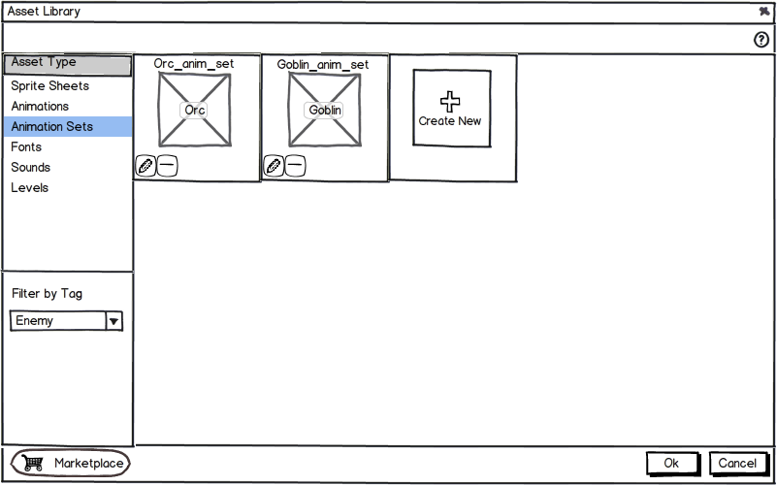
Asset Library
800x500
Notes:
Window Size – 800x500
Image Type – Will be populated with the following, Sprite Sheets, Animation, Animation Sets, Fonts, Sounds, and Levels. The user can click on 1 and will highlight that field and populate the right with all the selected type
Tag Filter – None will be selected by default; the list will also be populated with template specific tags and below those will be tags the user has created.
Marketplace Button – Will open a web browser directly to the Marketplace on the MMGD website
Help – Will bring up the Documentation for the Asset Library
Asset Container – A box around the Name of the Asset with a small preview
Cases:
Sprite Sheet – Edit button, Delete button, Frame Scroll Arrows (if celled)
Animation – Edit button, Delete button
Animation Sets – Shows the first animation defined in the set, Edit button, Delete button
Fonts – Edit button, Delete button
Sounds – Edit button, Delete button
Levels – Edit button (opens that scene)
Edit Button – Opens the specifies editor for the selected asset type with the information that was originally entered
Cases:
Sprite Sheet – Brings up the Image Tool
Animation – Brings up the Animation Tool
Fonts – Will bring up the Font Importer
Animation Sets – Only will be enabled on Templates that contain Animation Sets (Ex: Tower Defense)
Sounds – Will bring up the Sound Importer
Levels – Will open the Level Editor. There will be no edit button for levels.
Delete Button – Will bring up a prompt confirming that the user wants to delete the selected asset
Create New – Will open the specified editor for the selected asset type
Sprite Sheet – Brings up the Image Tool
Animation – Brings up the Animation Tool
Fonts – Will bring up the Font Importer
Animation Sets – Only will be enabled on Templates that contain Animation Sets (Ex: Tower Defense)
Sounds – Will bring up the Sound Importer
Levels – Will save the current scene, create a new scene and load it
OK Button – Selects the asset to use in the tool that the Asset Library was opened with. Only visible if the Asset Library was opened from another tool.
Cancel Button – Closes the Asset Selector, only visible if the Asset Library was opened from another tool

Slide 4
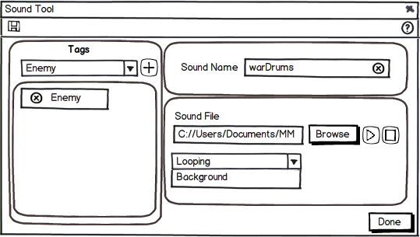
Sound Tool
Notes:
Window Size – 325x250
Sound Name – Will be blank when the user creates a new sound, if they have opened an existing sound it will populate with the name from that sound. The user must fill in a name before they can save the sound. They can only enter valid characters (A-Z, 0-9). A X at the end of the text field will remove the text
Help – Will open the Documentation for the Sound Importer
Sound file to Import – The Browse button will open a file dialog for the user to browse to the selected sound. The default will open to the project folder.
Looping Checkbox – Will have the audio loop
Controls – Allow the user to preview the audio file before saving, only Play and Stop will be available
Cancel – Will close the Sound Importer and not prompt the user
Save – Will save any changes the user has made to either a new sound or an existing one.
Cases:
If the Sound Name is blank, a prompt dialog telling the user that they must name the sound before saving
If a new sound is created and the name already exists, a prompt dialog will tell the user that “A Sound with this name already exists.”

Slide 5
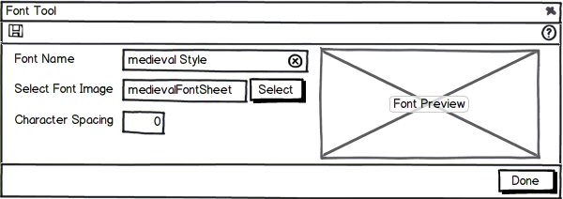
Font Tool
600x200
Notes:
Window Size – 600x200
Font Name – Will be blank when the user creates a new font, if they have opened an existing font it will populate with the name from that font. The user must fill in a name before they can save the font. They can only enter valid characters (A-Z, 0-9). A X at the end of the text field will remove the text
Select Font Image – The Browse button will open a file dialog for the user to browse to the selected image of the font sheet. By default it will open to the project folder.
Character Spacing – How much space between characters, like all other text editors
Preview – Will show a predefined word using the font sheet and the spacing specified
Help – Will bring up the help documentation for the Font Importer
Cancel – Will close the Font Importer and not prompt the user
Save – Will save any changes the user has made to either a new font sheet or an existing one.
Cases:
If the Font Name is blank, a prompt dialog telling the user that they must name the font before saving
If a new font is created and the name already exists, a prompt dialog will tell the user that “A Font with this name already exists.”

Slide 6
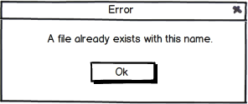
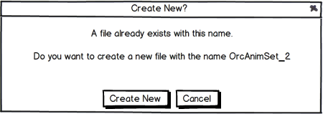
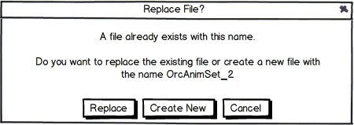
File Already Exists
P1
P2
P3
Notes:
Window Size – 275x125
Continue – Will remove any work the user has created or changed
Cancel – Will close the prompt dialog and not prompt the user

Slide 7
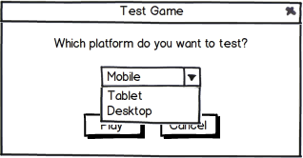
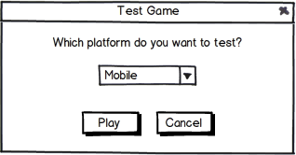
Test Game
Notes:
Window Size – 275x125
Continue – Will remove any work the user has created or changed
Cancel – Will close the prompt dialog and not prompt the user

Slide 8
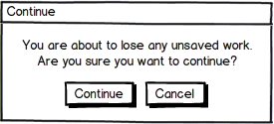
Continue Prompt
275x125
Notes:
Window Size – 275x125
Continue – Will remove any work the user has created or changed
Cancel – Will close the prompt dialog and not prompt the user

Slide 9
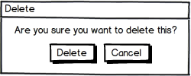
Delete Prompt
250x100
Notes:
Window Size – 250x100
Delete – Will delete what the user has selected
Cancel – Will close the prompt dialog and not prompt the user

Slide 10
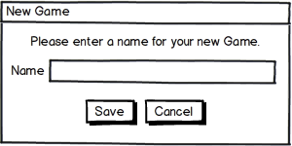
New Game Prompt
300x150
Notes:
Window Size – 300x150
Name: Text field for user to enter in the name of the Game Project
Save: Copies the template and creates a new file with the name the user has given
Cancel: Closes out the prompt and bring the user back to the Template Seletor

Slide 11
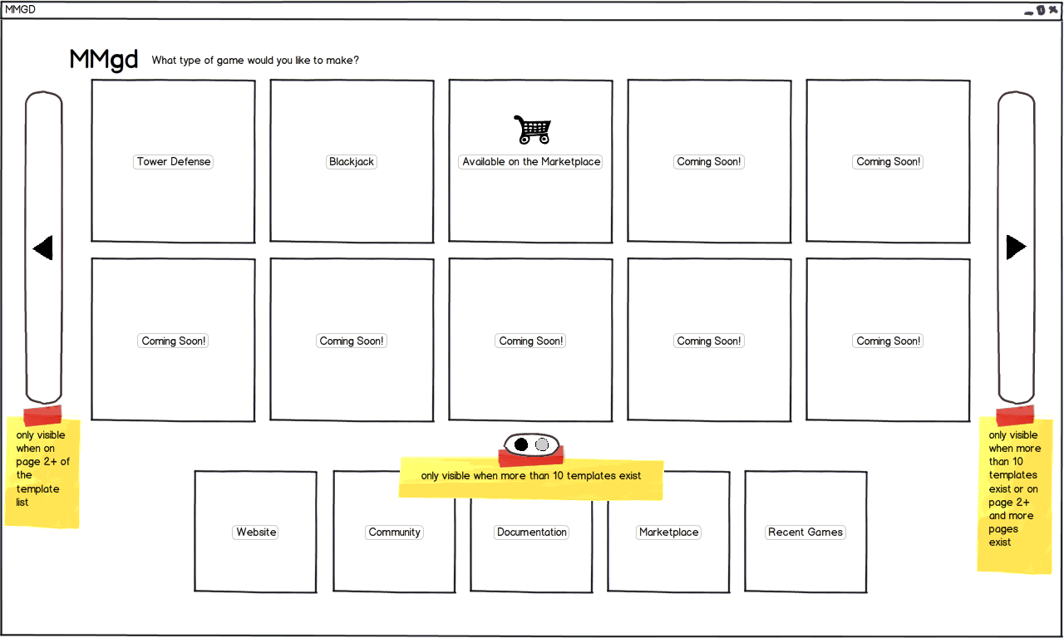
Template Select - Rough

Slide 12
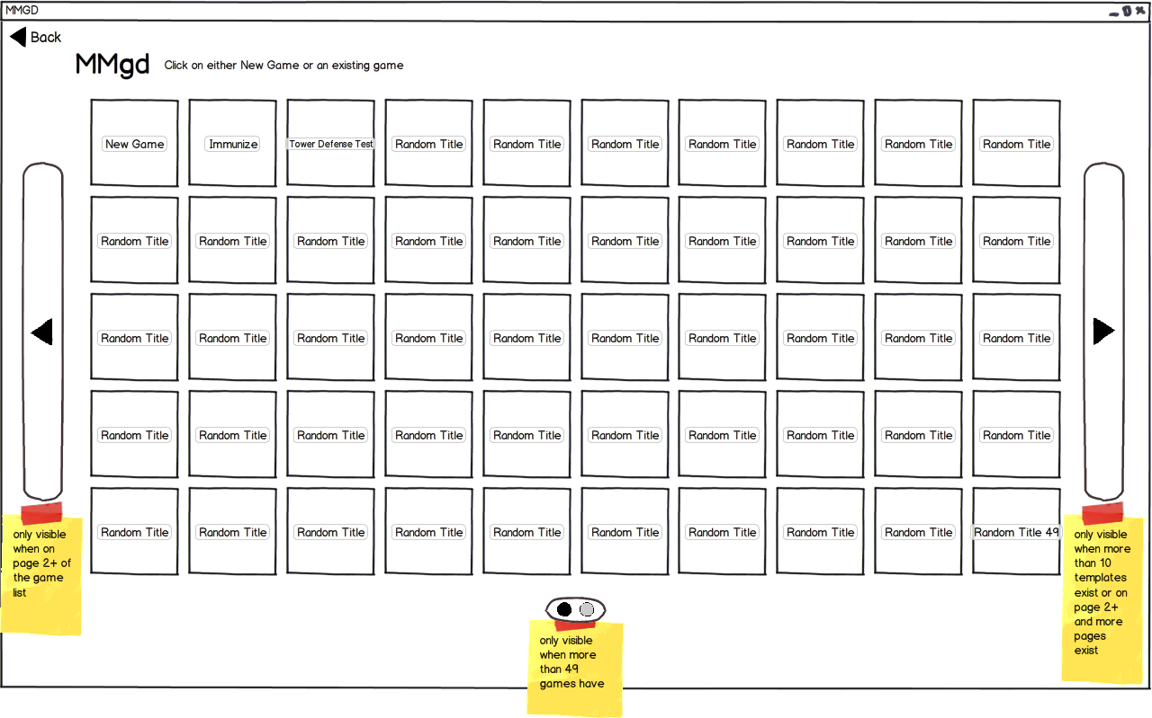
Template Select - Rough

Slide 13
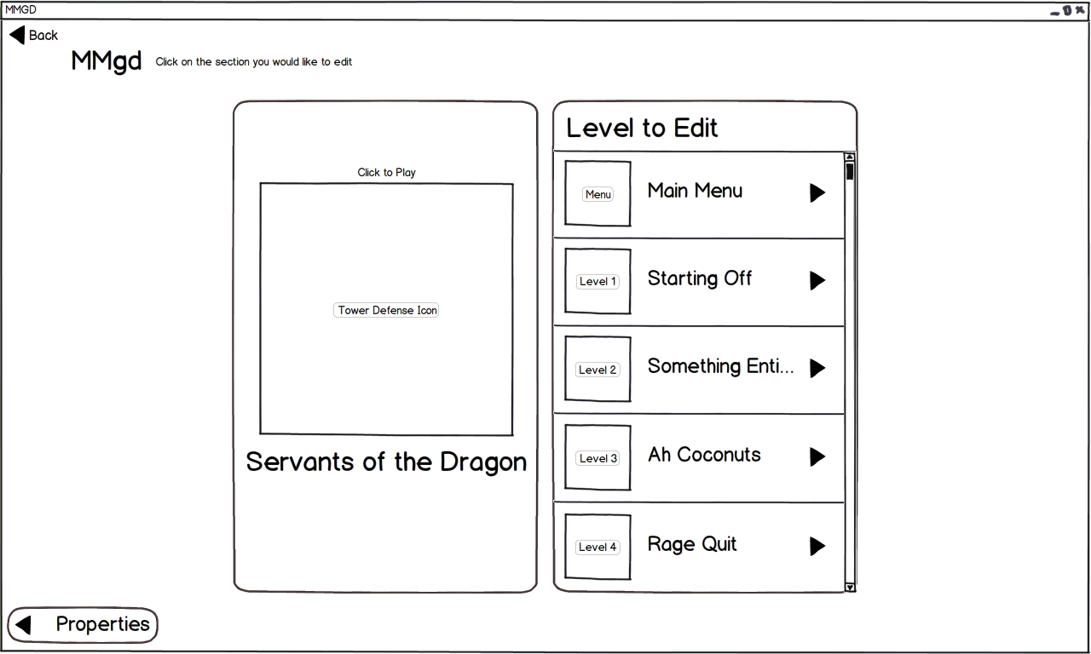
Template Select - Rough

Slide 14
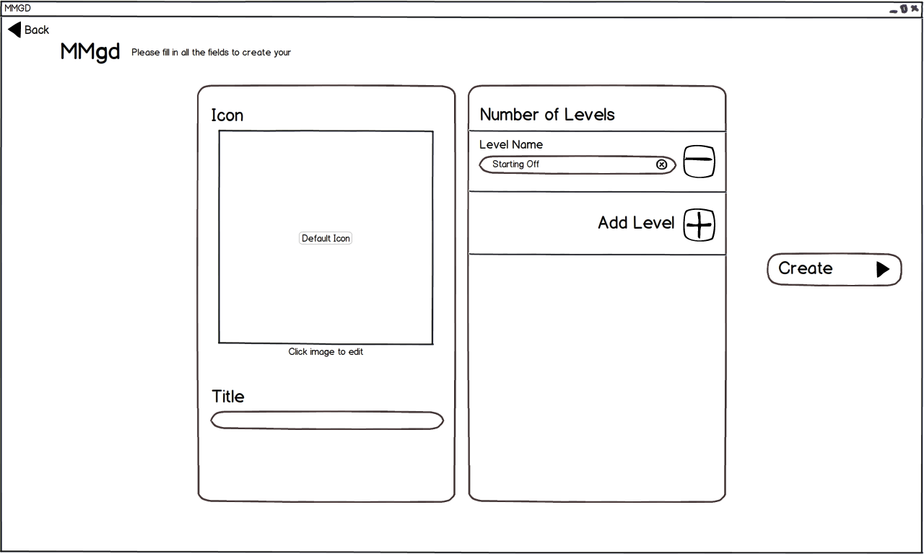
Template Select - Rough

Slide 15
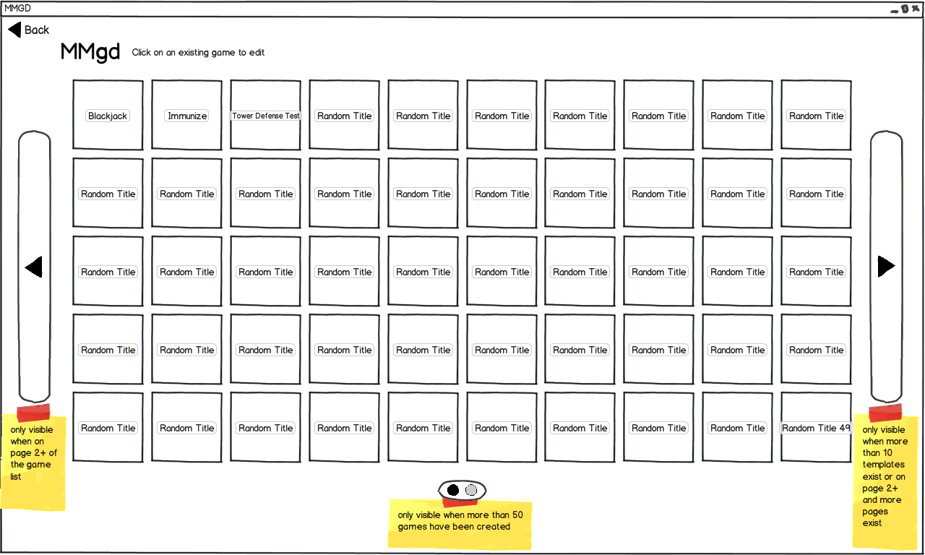
Template Select - Rough

Slide 16
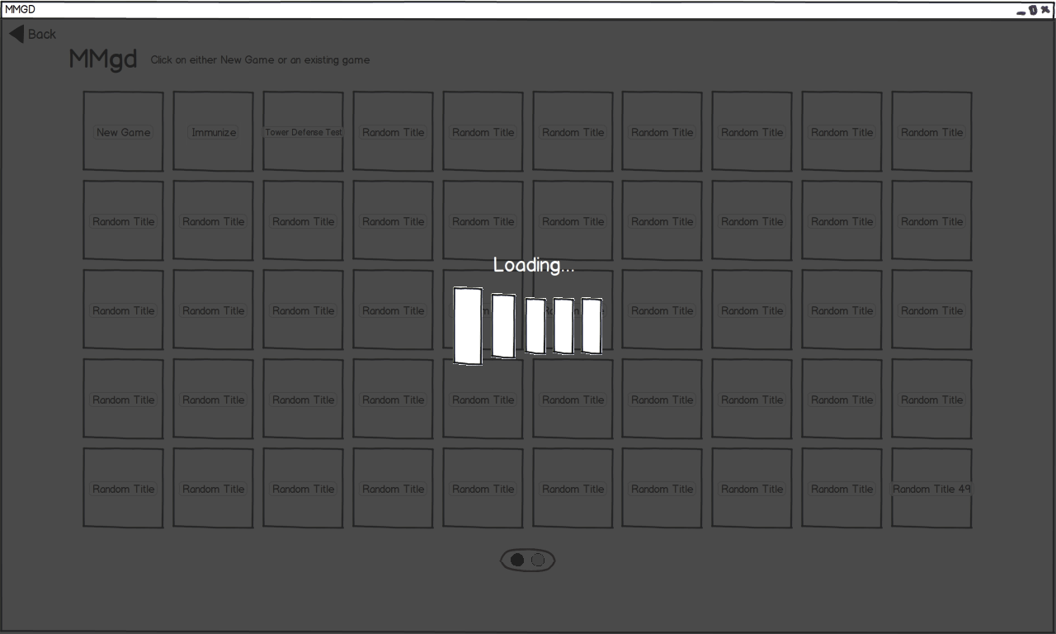
Template Select - Rough

Slide 17
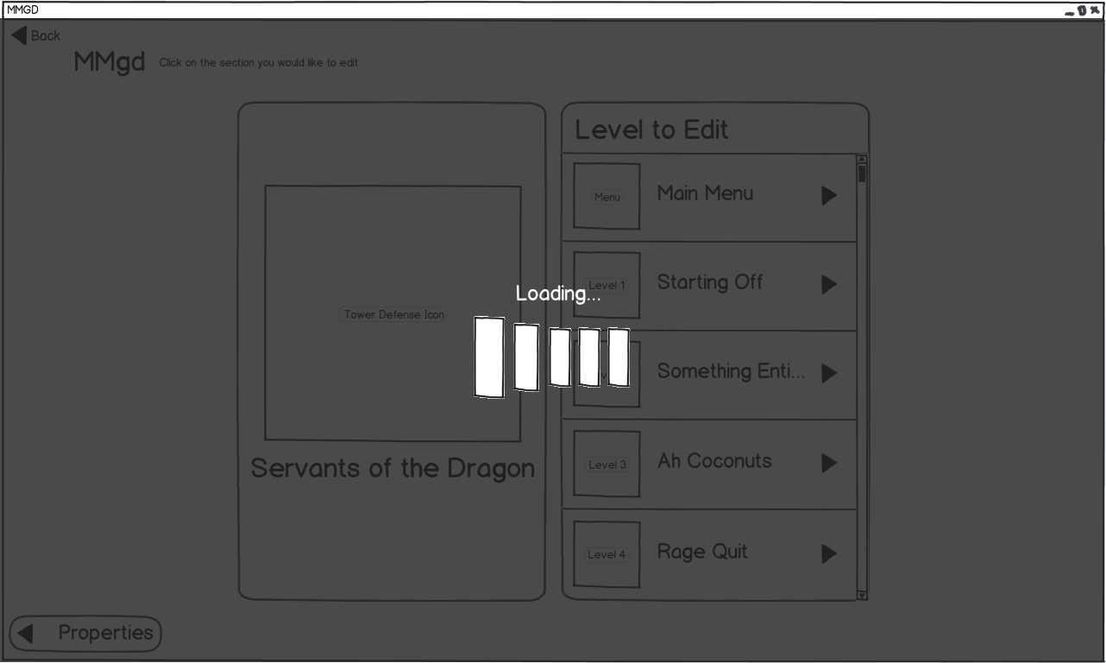
Template Select - Rough

Slide 18
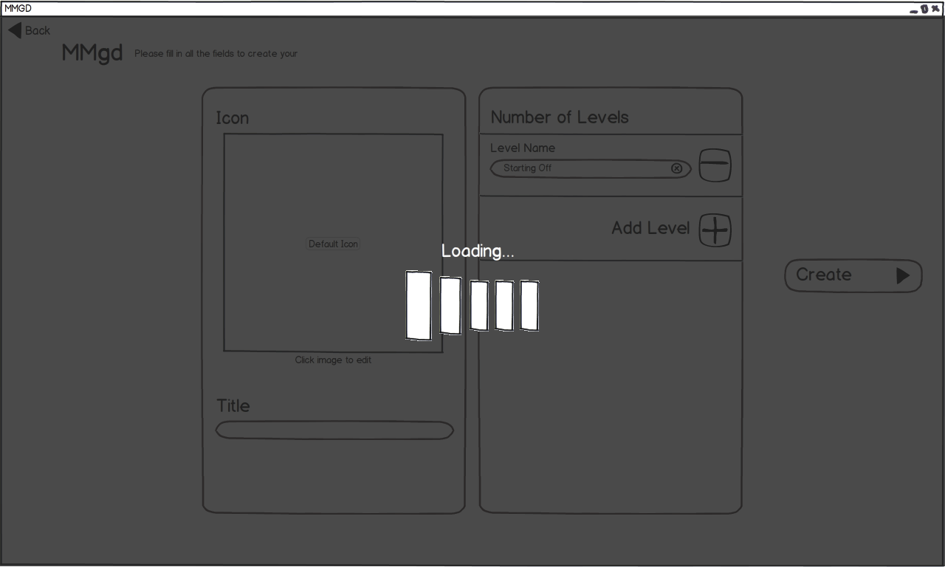
Template Select - Rough

Slide 19
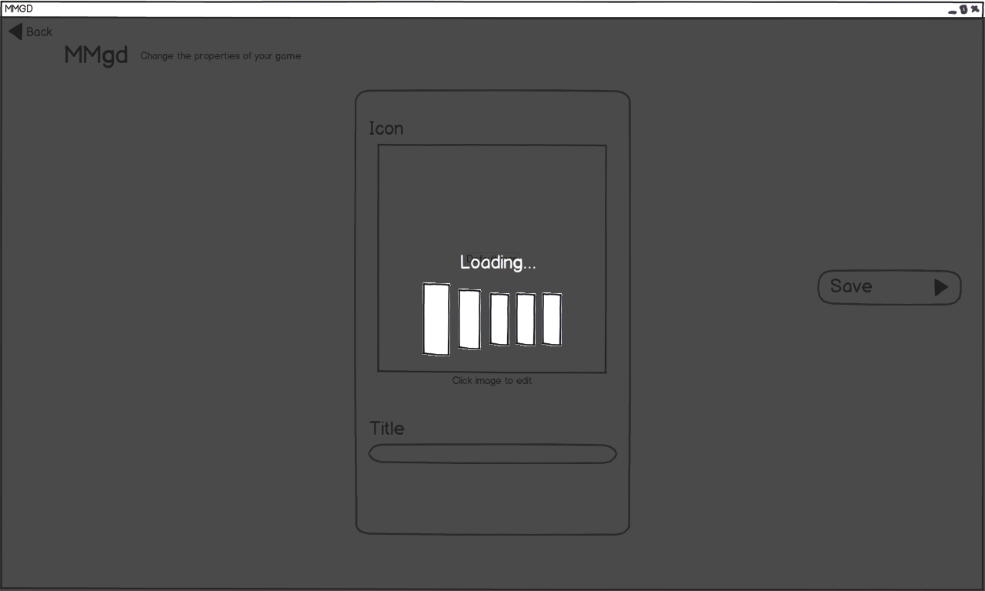
Template Select - Rough

Slide 20
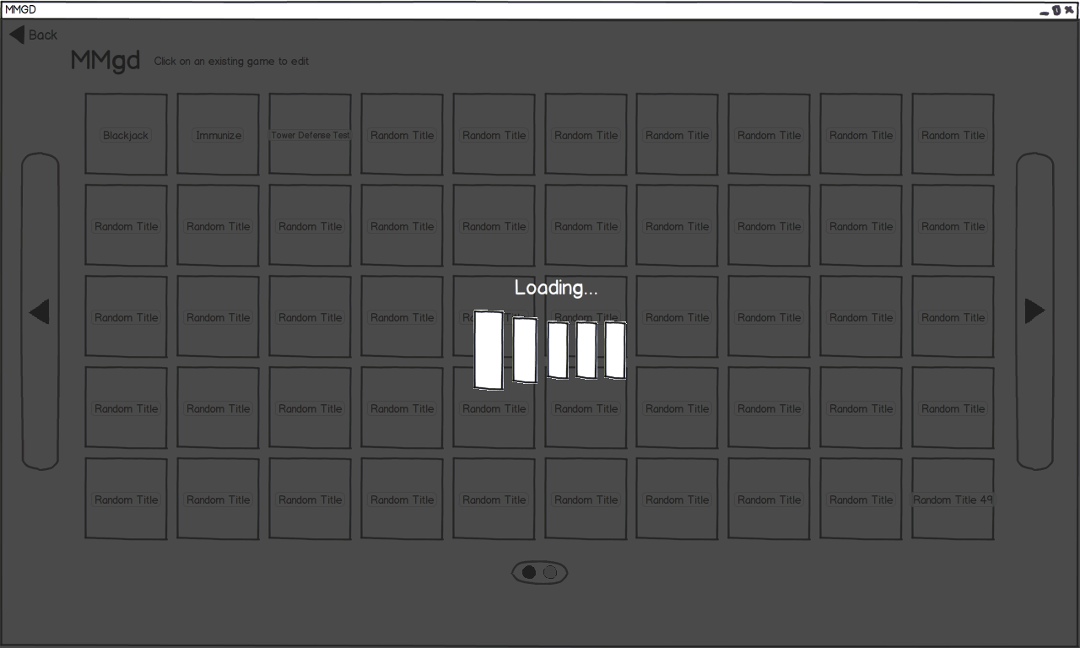
Template Select - Rough

Slide 21
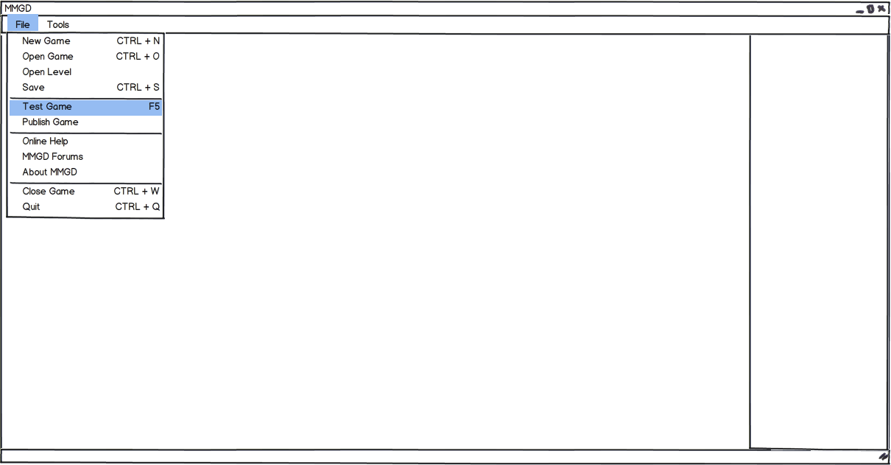
File Menus

Slide 22
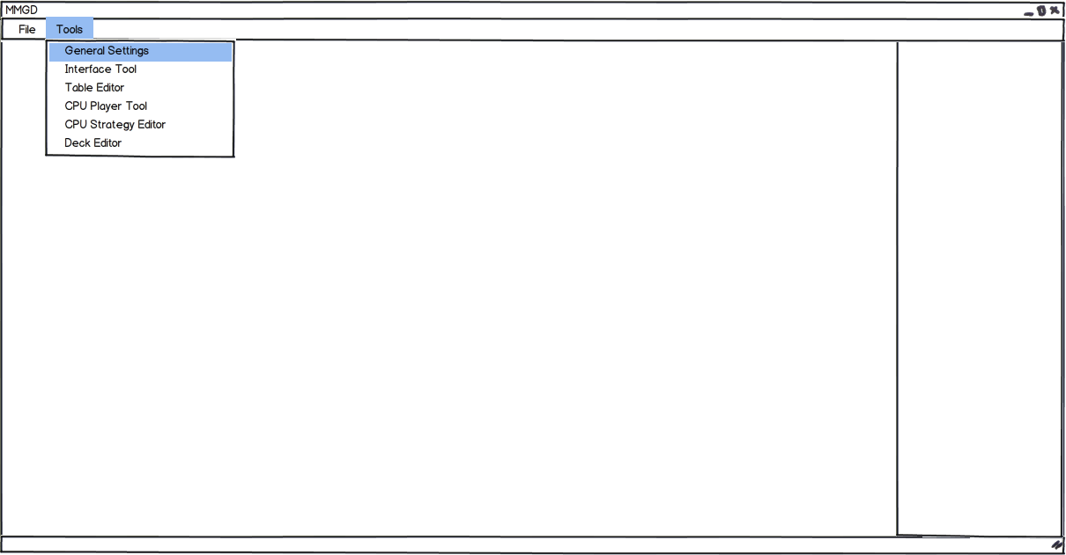
File Menus

Slide 23
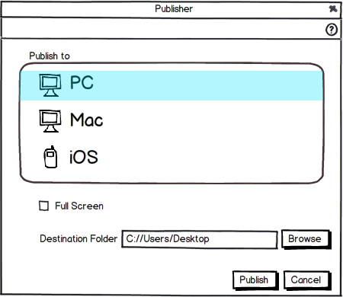
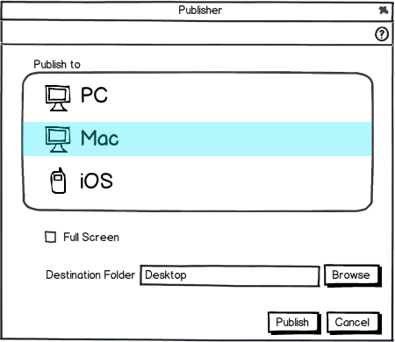
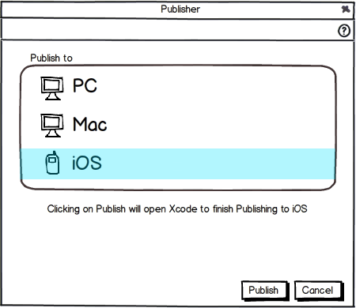
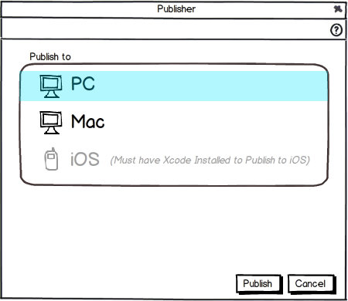
Publisher

